Slide 1
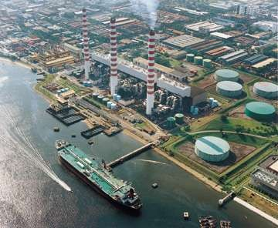
Chapter 13
Electricity

Slide 2
What is Electricity???
Definition:
Electricity is a form of energy that can be easily changed to other forms.

Slide 3
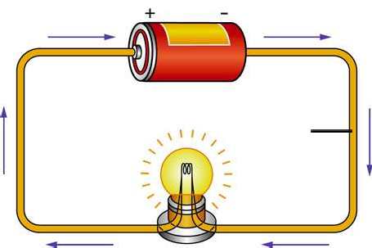
What is an Electric
Current???
electric cell
connecting wire
filament
flow of electrons
Definition:
An electric current is the rate of flow of electric charges in a circuit.

Slide 4
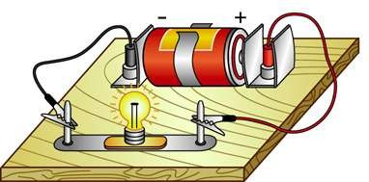
Electric Charges
Electric charges are made up of positive charges (protons) and negative charges (electrons).
When these charges flow in a circuit, a current is produced.

Slide 5
How does electricity flow?
The battery in a circuit gives energy to the electrons and pushes them around a circuit, from the negative terminal of the cell, round the circuit and back to the positive terminal of the cell.

